Slide 1
Sharp RDD and Local Regression
UIUC ECON 474 Econometrics of Policy Evaluation

Slide 2
Next lecture: Read Ch 6.2.7
Today
Review RDD identifying assumptions
Local regression
LAB: Replicate Reimers (2019)

Slide 3
RDD Identification Review
What occurs around the running variable cutoff

Slide 4
The RDD process: Ex. Lindo et al (2010)
RDD causally estimates a local (at cutoff) average treatment effect
Causal validation checks:
Check for bunching (running variable manipulation) and heaping (last lecture took 1 hour) with a running variable density figure
Check cutoff predicts treatment assignment with “first stage” RDD
Check for confounding variables with covariate and placebo RDD
Then estimate RDD of interest on entire sample
Then run heterogeneous effects RDD (subset on data on e.g. gender)

Slide 5
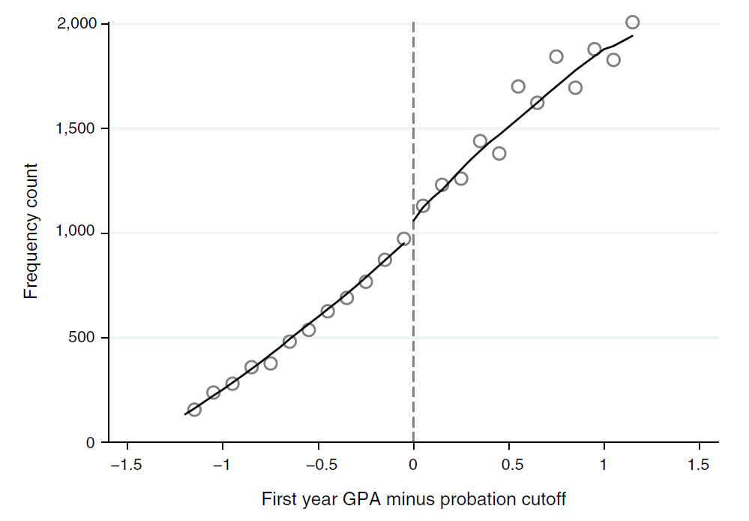
1. Bunching and heaping: density figure

Slide 6
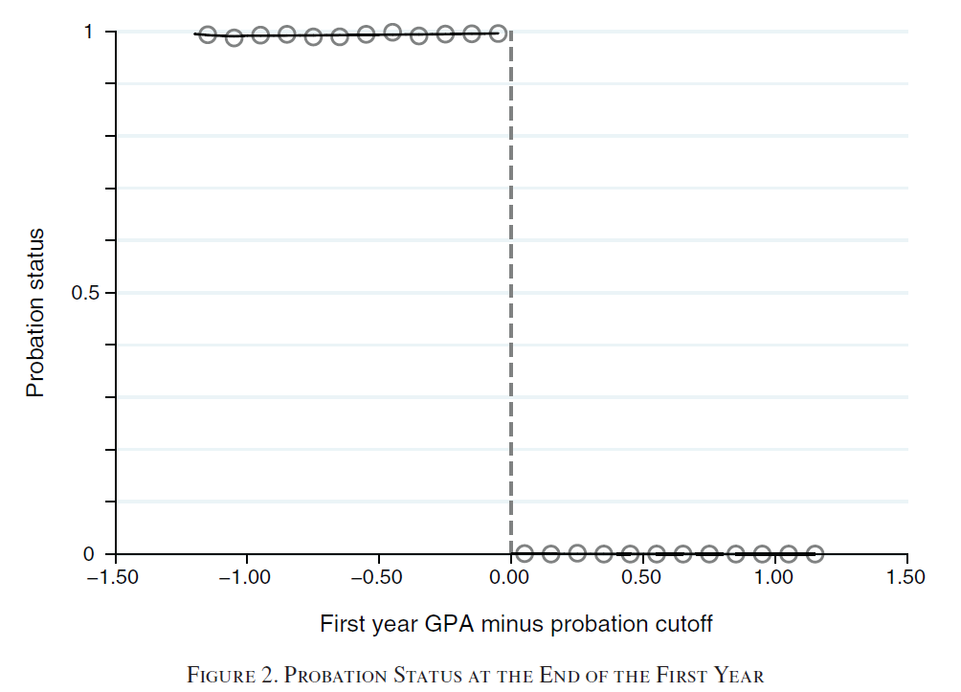
2. Cutoff predicts treatment: RDD “first stage”

Slide 7
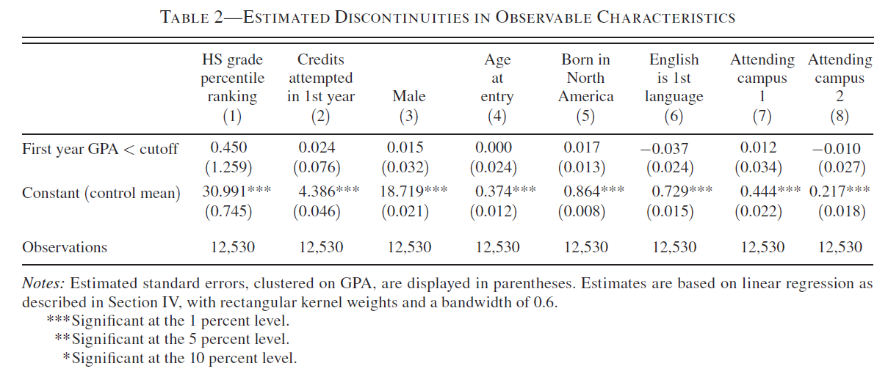
3. Confounding variables (endogenous cutoff)

Slide 8
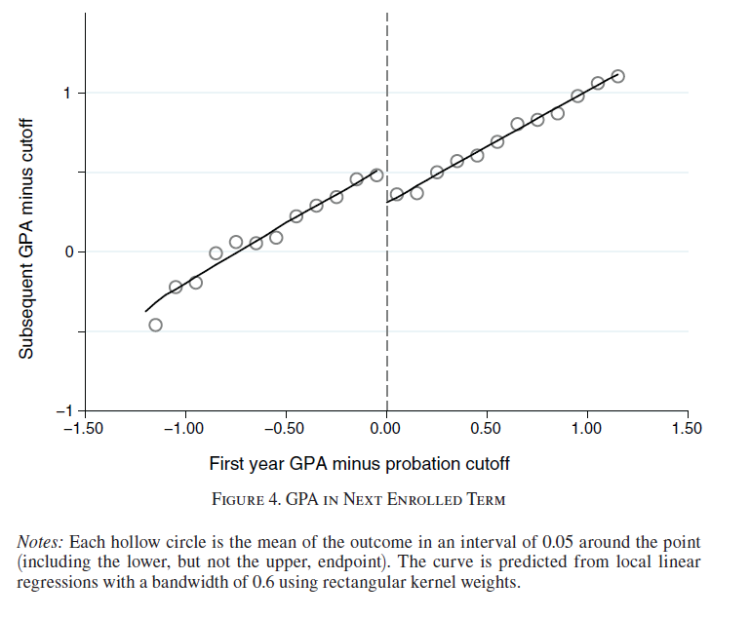
Main effect: show figure and RDD regression

Slide 9
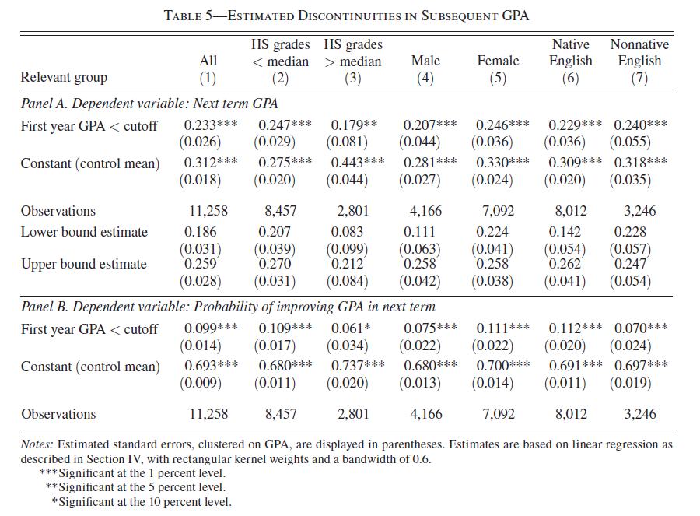
Heterogeneous effects

Slide 10
Local Regression
Smoothed polynomials

Slide 11
StatQuest is gold
Yay! Videos in class! LOESS and LOWESS
https://www.youtube.com/watch?v=Vf7oJ6z2LCc&t=317s&ab_channel=StatQuestwithJoshStarmer

Slide 12
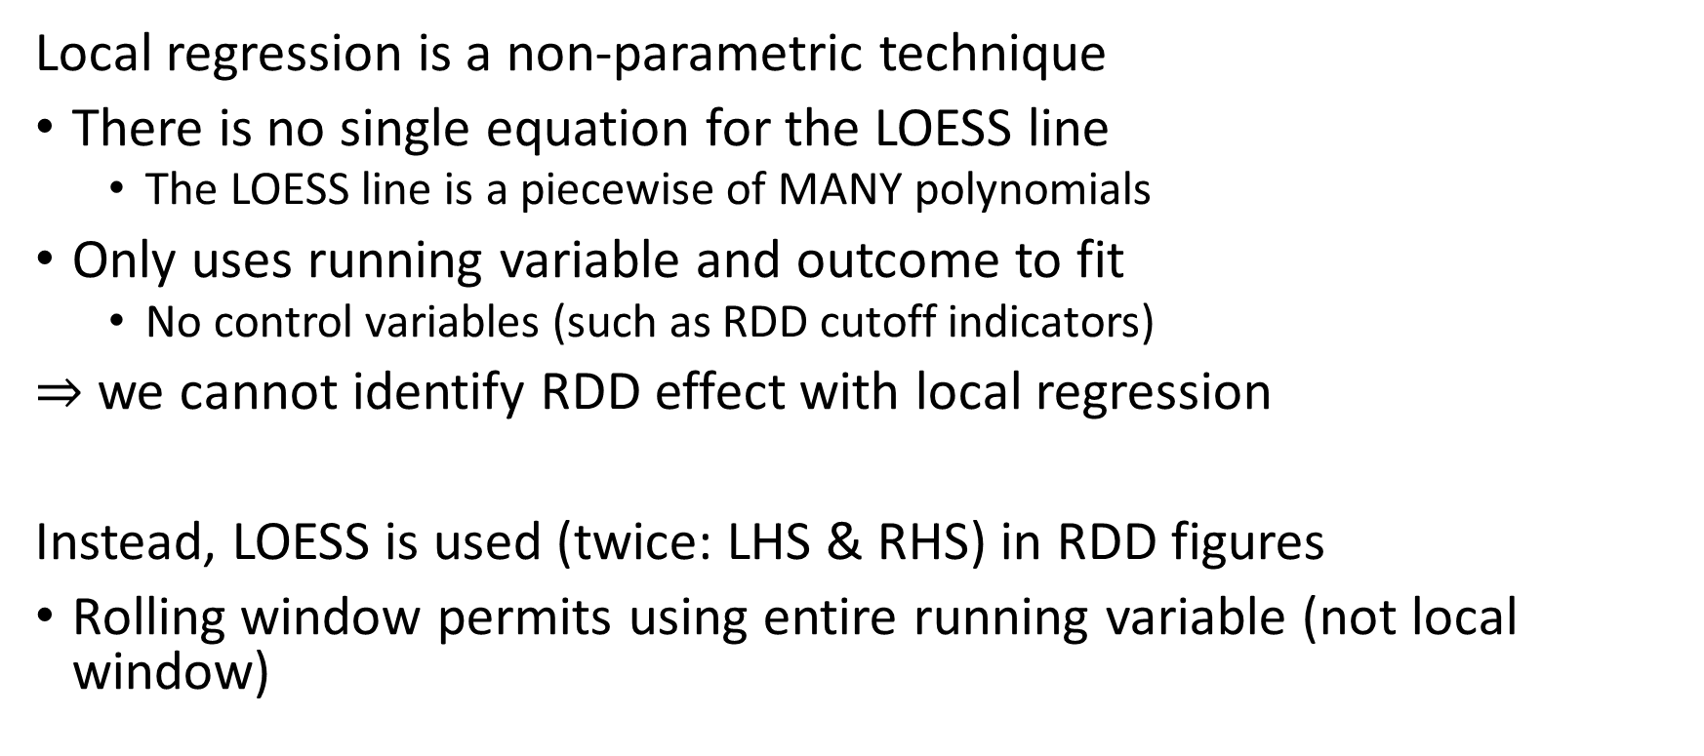
Local Regression is used for RDD figures only
Local regression is a non-parametric technique
There is no single equation for the LOESS line
The LOESS line is a piecewise of MANY polynomials
Only uses running variable and outcome to fit
No control variables (such as RDD cutoff indicators)
$⇒$ we cannot identify RDD effect with local regression
Instead, LOESS is used (twice: LHS & RHS) in RDD figures
Rolling window permits using entire running variable (not local window)

Slide 13
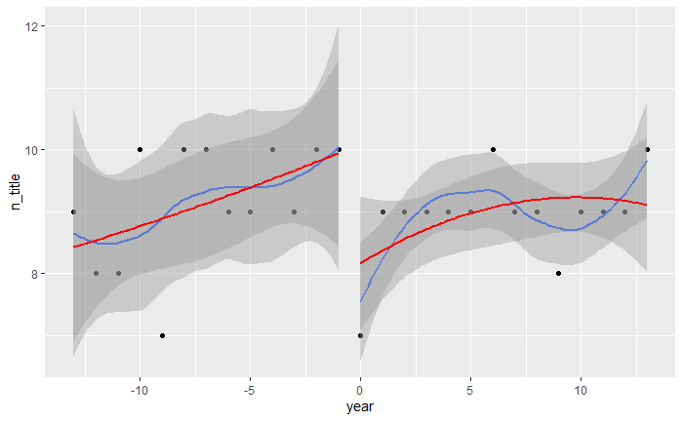
Quadratic (red) vs. LOESS quadratic figure (blue)

Slide 14
Implementation
LOESS()
span – proportion of data used for each local regression (0.75 = 75%)
degree – degree of polynomials in local regression
LOWESS()
f – same as LOESS() span
iter – iterations of outlier influence adjustment
delta – frequency of local regression estimation

Slide 15
Reimers (2019) Copyright and Generic Entry in Book Publishing
The 1998 Copyright Term Extension Act

Slide 16
Reimers (2019) Copyright and Generic Entry
Question: How does copyright affect the use of creative work?
Setting: 1998 Copyright Term Extension Act – books published in 1924 or later have their copy right extended
Method: use RDD centered at 1924 to predict number of in-print editions of each book
Ex) many editions/versions of Wealth of Nations on Amazon
Data: annual ten bestselling fiction titles of the years 1910 to 1936

